Slide 1



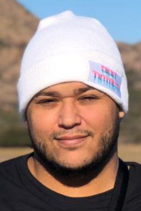
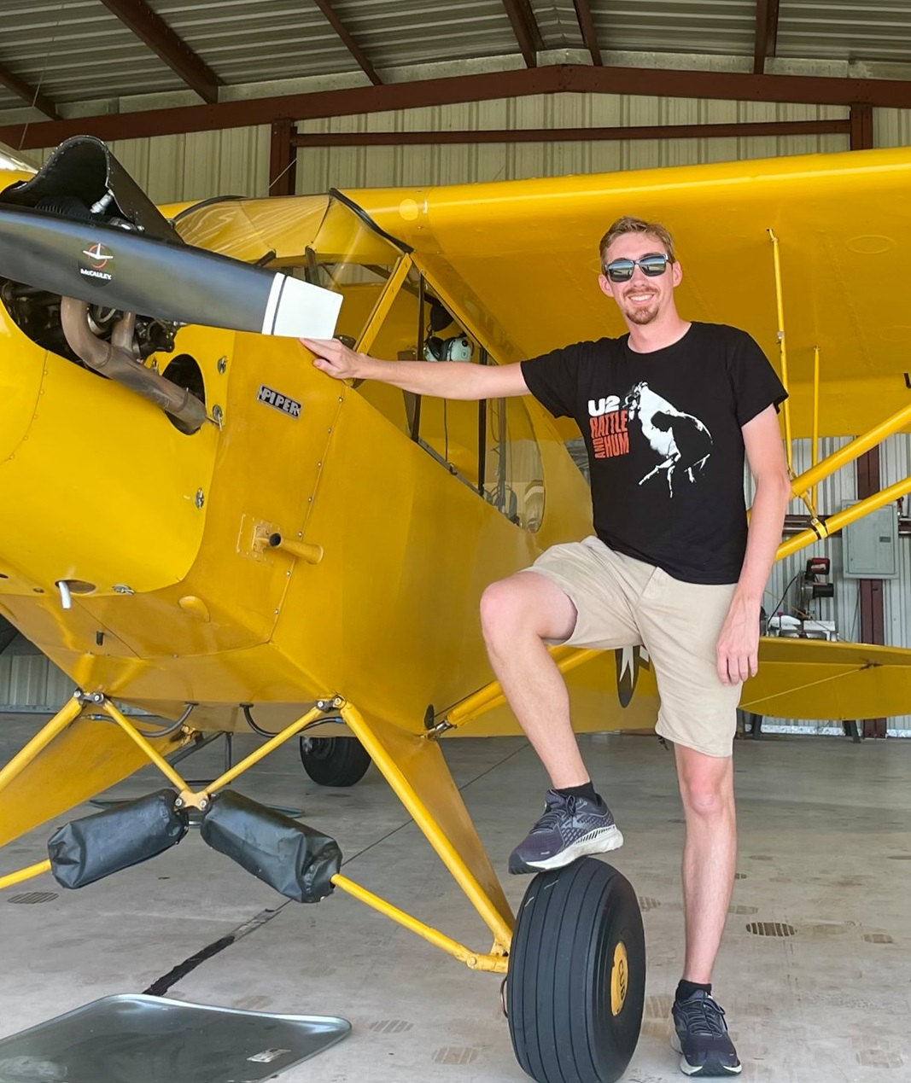
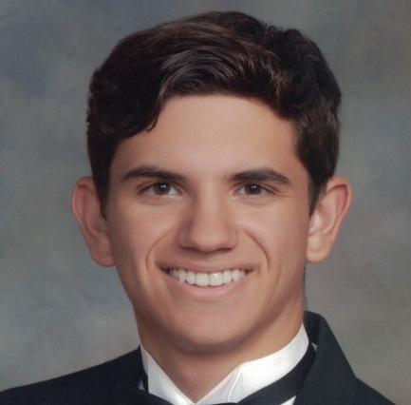

Group 27: Chromesthesia Simulation Device Final Demo
Angel Garcia – CpE
Wesley Ellery – CpE
Nicholas Alban – EE
Brooke Roeder- EE
Notes:
Angel Good afternoon everyone, we are group 27, my name is Angel Garcia,
For our project we are making a chromesthesia simulation device.

Slide 2
Project Description
Chromesthesia is an audio-visual variant of the phenomenon called Synesthesia. Synesthesia is when the simulation of one sensory or cognitive pathway leads to involuntary experience in a second sensory or cognitive pathway. The purpose of this project is to create a device that represents this phenomenon, where a user will vocalize sounds at different frequencies, and have that sound associated with a certain color. The device will also show on a display, sourced from a camera module, the location of where this sound is being vocalized from. Successful demonstration of this project is aimed at giving awareness to this phenomenon, which affects 1 in 3000 people.
Notes:
Angel Good afternoon everyone, we are group 27, my name is Angel Garcia,
For our project we are making a chromesthesia simulation device.

Slide 3
Engineering Specifications
Component(s) | Parameter | Specification
Microphones | Audio Input | Frequency Range 20Hz-20KHz
Microphones and Microprocessor | Audio Input and Processing | 70% accuracy up to 5 meter range
Microprocessor | Processing Speed | Associate color with designated note for defined frequency range under 2 seconds (i.e Red is associated with the key of F, frequency range 363-440Hz)
Camera | Power Consumption | 6.7 to 10 watts power consumption
Screen Display | Refresh rate | able to update a new overlay every second
Battery | Discharge Time | 2 hours

Slide 4
Project Demonstration

Slide 5
Overcoming Issues
We had several challenges during development. Our design was extremely complicated on the software level, and many rewrites of code were done.
Change from I2C protocol to UART mid-development.
We overcame these issues by meeting weekly and taking an Agile like approach to finishing development.

Slide 6
Stakeholder Feedback
Through various presentations and communication with experienced engineers, we realized early on our requirements were not well defined. We took time to better analyze what we had and wrote better requirements to drive development. This helped us achieve a better design in the end, since we could follow a process tree.

Slide 7
Project Impact
Hope to bring awareness to Chromesthesia Phenomenon with a lightweight, fun experience.
Help influence future designs and products with other similar phenomenon's that people experience.

Slide 8
Motivation and Lessons Learned
We chose this project because it was an idea that felt different than a lot of previous projects we researched. We wanted to bring awareness to this phenomenon and building a device that simulates this behavior was a great way to achieve that.
Biggest takeaway from working on this project is that things do not always go as intended. We had several rewrites and design changes that became overwhelming at times, but having clear communication resolved a lot of the issues we had.
Defining clearer requirements in the early stages of planning is an important lessons that will help us in the industry, as this sets up for development success.

